Slide 1
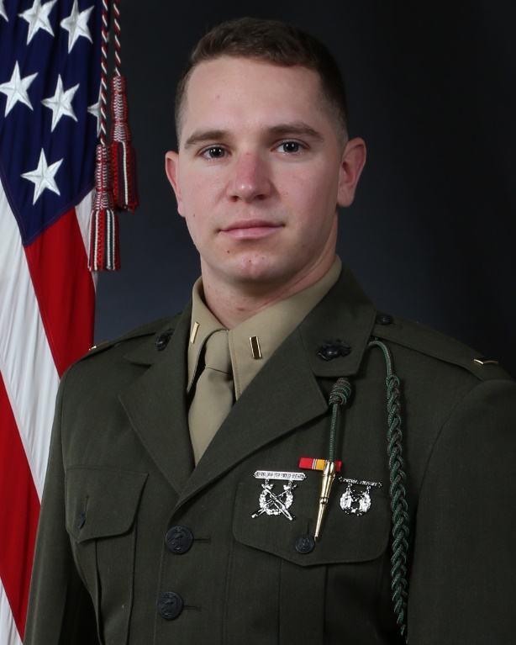
MARINE CORPS
EQUAL OPPORTUNITY PROGRAM
EQUAL OPPORTUNITY REPRESENTATIVE
2D BATTALION 6TH MARINES
2NDLT JUSTIN J. GREENBERG
CELL: (201) 450-5417
JUSTIN.GREENBERG@USMC.MIL
HP213, ROOM 148
All Marines seeking advice/guidance or those seeking to file a complaint of Prohibited Activities and Conduct to include ABUSE (HAZING, BULLYING, OSTRACISM, RETALIATION), HARASSMENT (to include SEXUAL HARASSMENT), WRONGFUL DISTRIBUTION OF INTIMATE IMAGES, DISSIDENT AND PROTEST ACTIVITY (including SUPREMACIST ACTIVITY), or UNLAWFUL DISCRIMINATION based on RACE, COLOR, SEX (to include SEXUAL IDENTITY), RELIGION, NATIONAL ORIGIN, AND SEXUAL ORIENTATION can do so with your unit EOR or EOA.
The EOR is the primary source to provide advice and guidance to Marines seeking assistance. The chain of command is the primary and preferred channel to identify, process, and resolve complaints.

